Slide 1
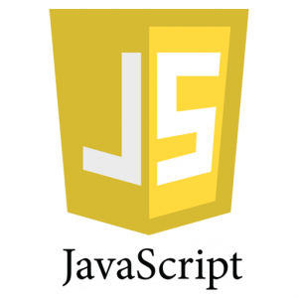
Notes:
First class object

Slide 2
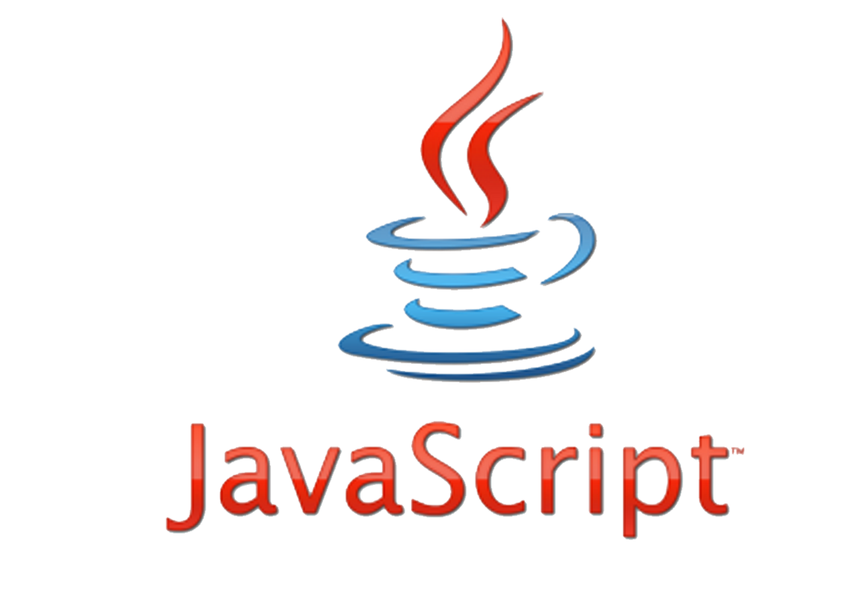
JavaScript Is Nothing to do with JAVA
It is used to make webpages interactive and provide online programs.
Notes:
What is HTML?
HTML is the standard markup language for creating Web pages.
HTML stands for Hyper Text Markup Language
HTML describes the structure of Web pages using markup
HTML elements are the building blocks of HTML pages
HTML elements are represented by tags
HTML tags label pieces of content such as "heading", "paragraph", "table", and so on
Browsers do not display the HTML tags, but use them to render the content of the page

Slide 3
JavaScript
JavaScript is a scripting language.
Designed to add interactivity to HTML pages and create dynamic web sites.
i.e. Change contents of document, provide forms and controls, animation, control web browser window, etc.
JavaScript statements embedded in an HTML page can recognize and respond to User Events.
JavaScript is very simple and flexible.
Powerful, beautiful and full-fledged dynamic Programming Language

Slide 4
Languages Types
Markup Language
Scripting Language
Programming Language
Notes:
Scripting Language
- Interpreted command by command, and remain in their original form.
Programming Language
Compiled, converted permanently into binary executable files (i.e., zeros and ones) before they are run.
Markup Language
A text-formatting language designed to transform raw text into structured documents, by inserting procedural and descriptive markup into the raw text.

Slide 5
Scripting vs. Programming vs. Markup Language
Scripting Language
Interpreted command by command and remain in their original form.
Programming Language
Compiled, converted permanently into binary executable files (i.e., zeros and ones) before they are run.
Markup Language
A text-formatting language designed to transform raw text into structured documents, by inserting procedural and descriptive markup into the raw text.

Slide 6
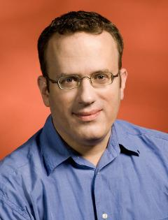
Founder Brendan Eich
Late 1995

Slide 7

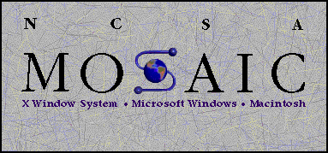

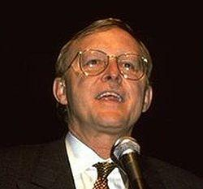

1993 introduce images
1995 Font Element And Text Decoration
Brendan Eich
James H. Clark
Marc Andreessen
Notes:
Mozaic first popular browser (images) 1993
Netscape 1995 (Mozaic Developers Head Hunting) font element and text formatting
1995 bring Berdan Eich(CTO of firefox) to developer Events

Slide 8

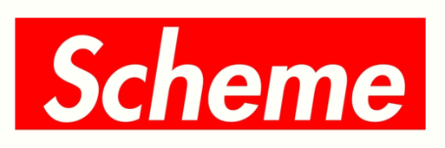


2 weeks
LiveScript
Notes:
Scheme 1975 => function as a First class object(Passed and returned from functions and can be property on class)
Self 1989 by Xerox => First Prototypal Programing Language (No Classes it only objects that can inherits from object).
1992 sun bye small talk (oop language) & self and create java
1995 sun decided to kill one of the types of programing => kill Prototypal (self)
Briden Eich create LiveScript from the best of the three languages

Slide 9




1995
1996
JavaScript
JScript
1997
Script

Slide 10

V1.0
V1.3 ECMAScript 1 & 2
V1.5 ECMAScript 3
V1.6 ECMAScript for XML
V1.8.5 ECMAScript 5
ECMAScript 6

Slide 11

What we can do with
JavaScript
Web Application
Infinite Scrolling
IOT
Parallax
Games

Slide 12
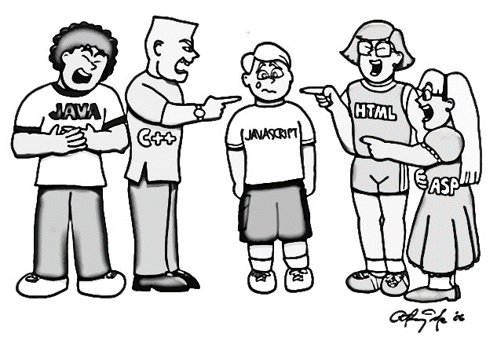
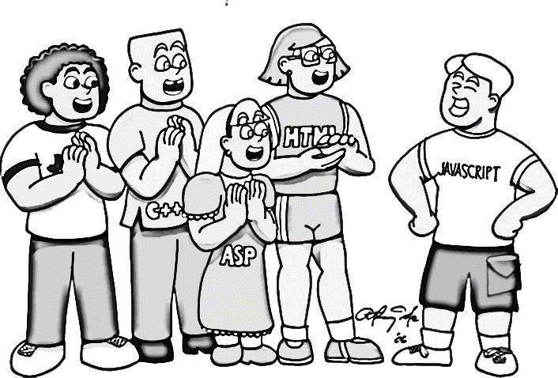
After
Before

Slide 13
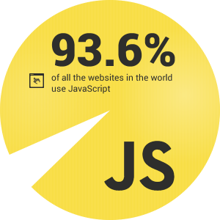

Slide 14
JavaScript Characteristics
Case sensitive.
Object-based.
Event-Driven.
Browser-Dependent.
Interpreted language.
Dynamic.

Slide 15
Where we can write
JavaScript Code
HTML File
External File
Script Tag
Head or Body
Filename.js + Script tag
Event Handling

Slide 16
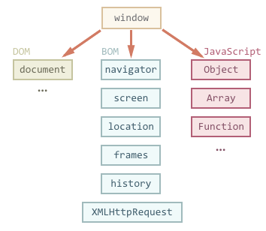
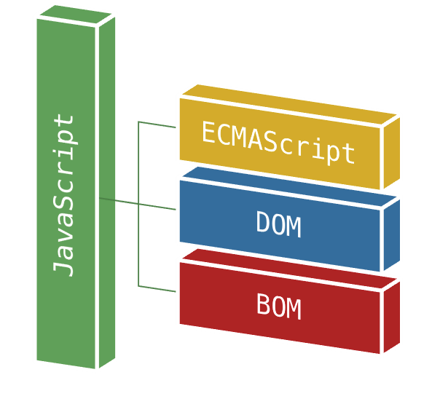

Slide 17
ECMAScript
Notes:
https://kangax.github.io/compat-table/es6/

Slide 18
Data Type
Name
Variables
Variable
Value
Address

Slide 19
Variables Names
First char a-z or A-Z or _
Other char a-z or A-Z or _ or 0-9
No whitespaces
Avoid reserved words
Case-sensitive

Slide 20
Number
String
Data Types
Boolean
Null (treated as an "empty" variable)
Undefined (NOT assigned yet)
NaN (Not a Number)
Objects
Notes:
Value
Example
Number
Any numeric value (e.g., 3, 5.3, or 45e8) double 8 byte => .1 + .2 = .3000000000000004 take care
String every char 2 byte
Any string of alphanumeric characters
(e.g., "Hello, World!", "555-1212" or "KA12V2B334")
Boolean
True or False values only
null
A special keyword for the null value
undefined
A special keyword for the unassigned value

Slide 21
var x = 5
Declaration
Variable
NAME
VALUE
Notes:
If you redeclare a JavaScript variable, it will not lose its original value.
var x=5; var x;
After the execution of the statements above, the variable x will still have the value of 5. The value of x is not reset (or cleared) when you redeclare it.

Slide 22
Disabled JS
<noscript>any text</noscript>

Slide 23
Comments
// single line of text
/* multiline
of text */

Slide 24
Operator | Description | Example | Result
+ | Addition | x=y+2 | x=7
- | Subtraction | x=y-2 | x=3
* | Multiplication | x=y*2 | x=10
/ | Division | x=y/2 | x=2.5
% | Modulus (division remainder) | x=y%2 | x=1
++ | Increment | x=++y | x=6
-- | Decrement | x=--y | x=4
Arithmetic Operators

Slide 25
Operator | Example | Description
= | x = y Sets x to the value of y | Assigns the value of the right operand to the left operand
+= | x += y i.e. x = x + y (15) | Adds together the operands and assigns the result to the left operand.
–= | x –= y i.e. x = x – y (5) | Subtracts the right operand from the left operand and assigns the result to the left operand.
*= | x *= y i.e. x = x * y (50) | Multiplies together the operands and assigns the result to the left operand.
/= | x /= y i.e. x = x / y (2) | Divides the left operand by the right operand and assigns the result to the left operand.
%= | x %= y i.e. x = x % y (0) | Divides the left operand by the right operand and assigns the result to the left operand.
Assignment Operators

Slide 26
Operator | Description | Example
== | is equal to | x==8 is false
=== | is exactly equal to (value and type) | x===5 is true x==="5" is false
!= | is not equal | x!=8 is true
> | is greater than | x>8 is false
< | is less than | x<8 is true
>= | is greater than or equal to | x>=8 is false
<= | is less than or equal to | x<=8 is true
Comparison Operators
Notes:
== if different types evaluate to Number() if one of them is null return false

Slide 27
Operator | Definition
&& | Logical "AND" – returns true when both operands are true; otherwise it returns false (Gard Operator)
|| | Logical "OR" – returns true if either operand is true. It only returns false when both operands are false (Default Operator)
! | Logical "NOT"—returns true if the operand is false and false if the operand is true. This is a unary operator and precedes the operand
Logical Operators
Notes:
&& return one of the parameters not bool

Slide 28
Ternary Operator
(condition) ? true : false
var temp = 120 ;
var color = (temp>100) ? ”red” : “blue” ;
// the value of color will be red
Notes:
temp=120
newvar=(temp>100) ? ”red” : “blue” // the value of newvar will be “red”
temp=20
newvar=(temp>100) ? ”red” : “blue” // the value of newvar will be “blue”
Comma operator
var k=0, i, j=0;

Slide 29
typeof Operator
typeof Operator
A unary operator returns a string that
represents the data type.
The return values of using typeof can be one of the following:
"number", "string", "Boolean", "undefined", "object", or "function".
Example:
var myName = “JavaScript”;
typeof myName; //string

Slide 30
JavaScript Expression
An expression is a part of a statement that is evaluated as a value.
Main types of expressions:
Left-hand-side “Assignment”
a = 25; 🡺 assign RHS to variable of LHS
Arithmetic
10 + 12; 🡺evaluates to sum of 10 and 12
String
“Hello” + ” All !!”; 🡺 evaluates to new string
Logical
25<27 🡺 evaluates to the Boolean value

Slide 31
Coercion
Coercion is forcing conversion from one data type to another when expression is executed giving a result without causing any error.
Sometimes gives surprising results from human perspective
JavaScript engine coerce
Number to string 1+”2”🡺12
Boolean to number 3<2<1🡺true
Both undefined and null coerce to false

Slide 32
Operator Precedence
The operators that you have learned are evaluated in the following order (from highest precedence to lowest):
1. Parentheses(())
2. Multiply/divide/modulus (*, /, %)
3. Addition/Subtraction (+, -)
4. Relational (<, <=, >=, >)
5. Equality (==, !=)
6. Logical and (&&)
7. Logical or (||)
8. Conditional (?:)
9. Assignment operators (=, +=, -=, *=, /=, %=)
Notes:
Example:
5 + 3 * 2 = 11 🡺 3*2=6 , then 6+5 = 11.
BUT
(5 + 3) * 2 = 16 🡺 5+3 = 8 , then 8*2 = 16.

Slide 33
if
for
while
Control Statements
Conditional Statements
Loop Statements
switch
do-while
for in
Notes:
if (condition)
{ statements if condition is true; }
else { statements if condition is false; }
switch (expression)
{ case label1:statements
break
case label2:statements
break
default : }

Slide 34
If
switch
if (condition) { do something; }
else if (Condition) { do something else; }
else { do something else; }
switch (expression) { case value1: statements break; case value2: statements break; default : statements }
Conditional Statements
Notes:
if (condition)
{ statements if condition is true; }
else { statements if condition is false; }
switch (expression)
{ case label1:statements
break
case label2:statements
break
default : }

Slide 35
for
while
for ( var index=0;index<10;index++) { console.log(“ number”, index) }
while (condition) { statements }
Loop Statements
do-while
for in
do { statements } while (condition)
for (variablename in object) { statements }

Slide 36
Breaking Loops
break
The break statement will break the loop and continue executing the code that follows after the loop (if any).
continue
The continue statement will break the current loop and continue with the next value

Slide 37
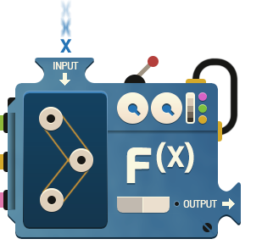
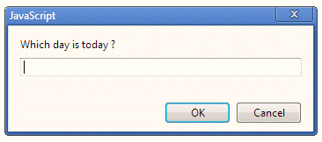
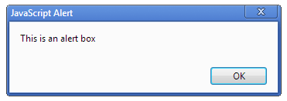
Input
Output

Slide 38
Console
console.log(any data)
console.warn(any data)
console.error(any data)

Slide 39
Communicating with the User
Four ways of communication:
one that displays a text message in a pop-up window
one that asks for information in a pop-up window
one that asks a question in a pop-up window
and one that displays a text message in the browser window.

Slide 40
Dialogues and Alerts
There are 3 types of dialogues:
alert()🡺 Show a message box with one button, has no return.
confirm() 🡺 Show a message box with 2 buttons (OK and Cancel).
Returns true 🡺 OK pressed.
Returns false 🡺 Cancel pressed.
prompt() 🡺 Show a message box with 2 buttons (OK and Cancel) and a textbox
Returns the text in textbox 🡺OK pressed
Returns null 🡺 Cancel pressed

Slide 41
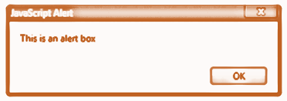
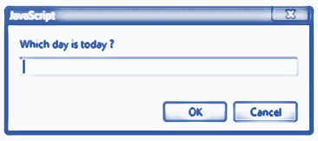
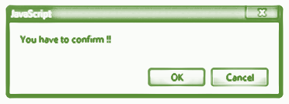
Popup Boxes

Slide 42
Outputting text with JavaScript
(on the current window)
You can write out plain text or you can mix HTML tags in with the text being written using document.write()
to return text to the browser screen.
document.write(“ ”)
Example: document.write(”Hello There!“)

Slide 43
JavaScript Functions
A function is an organized block of reusable code (a set of statements) that handles and performs actions generated by user events.
Functions categorized into
built-in functions improve your program's efficiency and readability.
user defined functions , created by developer to make your programs scalable.
Function executes when it is called.
from another function
from a user event, called by an event or
from a separate <script> block.

Slide 44
Global Properties & functions
Function | Description
eval() | Evaluates a string and executes it as if it was script code
isFinite() | Determines whether a value is a finite, legal number
isNaN() | Determines whether a value is an illegal number
Number() | Converts an object's value to a number
parseFloat() | Parses a string and returns a floating-point number
parseInt() | Parses a string and returns an integer
String() | Converts an object's value to a string
Notes:
used to test string
isNaN(0/0) //returns true isNaN("348a") //returns true isNaN(“back") //returns true isNaN("348") //returns false

Slide 45
JavaScript Debugging Errors
Syntax
HTML
Runtime
Logical
Inaccurate capitalization, or forgetting to close quotation marks or parentheses).
Forgetting a fundamental HTML step will cause your JavaScript code to fail.
Technically correct but performs an invalid function, such as dividing by zero, generate script that calls a non-existent function
Code that may not return an error but does not produce the result you expect)

